Slide 1
Image Super-Resolution Using Very Deep Residual Channel Attention Networks
Yulun Zhang, Kunpeng Li, Kai Li, Lichen Wang, Bineng Zhong, and Yun Fu, ECCV, in 2018

Slide 2
QUESTION
Whether deeper networks can further contribute to image SR to image SR and how to construct very deep trainable networks remains to be explored.
Most recent CNN-based methods treat channel-wise features equally, which lacks flexibility in dealing with different types of information.

Slide 3
Methods
Propose a residual channel attention network (RCAN) to obtain very deep trainable network.
Propose residual in residual (RIR) structure, where the residual group (RG) serves as the basic module and long skip connection (LSC) allows residual learning in a coarse level.
Propose channel attention (CA) mechanism to adaptively rescale each channel-wise feature by modeling the interdependencies across feature channels.

Slide 4
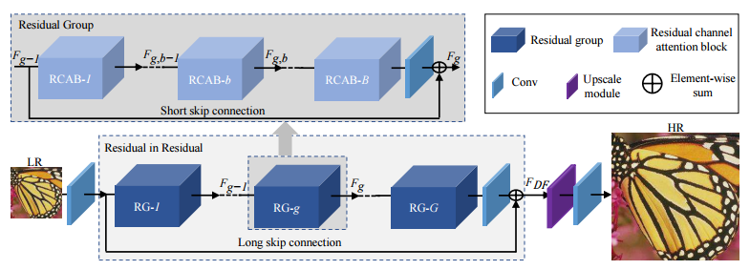
Residual Channel Attention Network (RCAN)
1
2
3
4
Figure 1: The structure of residual channel attention networks
RCAN contains four parts: 1-shawllow feature extraction, 2-residual in residual (RIR)
deep feature extraction, 3-upscale module, 4-restruction part
we will pay more attention to the article important part, namely the second part.

Slide 5
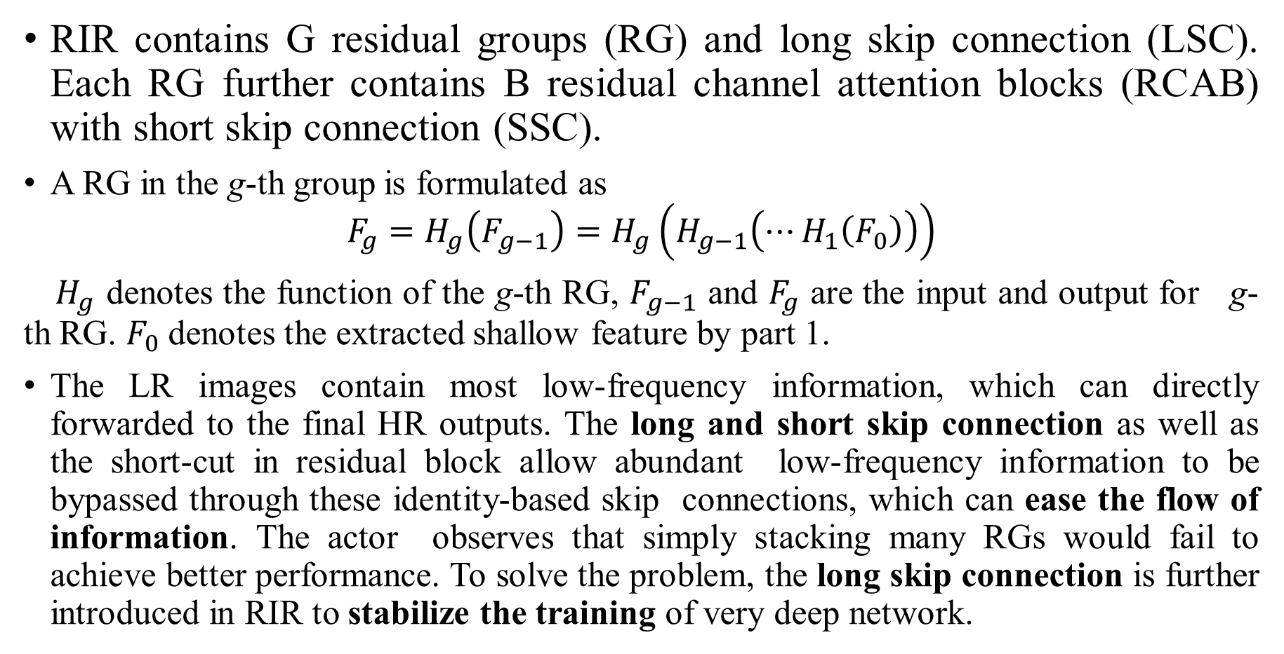
Residual in Residual (RIR)
RIR contains G residual groups (RG) and long skip connection (LSC). Each RG further contains B residual channel attention blocks (RCAB) with short skip connection (SSC).
A RG in the g-th group is formulated as
$$F_{g}=H_{g}\left(F_{g−1}\right)=H_{g}\left(H_{g−1}\left(⋯H_{1}\left(F_{0}\right)\right)\right)$$
$H_{g}$ denotes the function of the g-th RG, $F_{g−1}$ and $F_{g}$ are the input and output for g-th RG. $F_{0}$ denotes the extracted shallow feature by part 1.
The LR images contain most low-frequency information, which can directly forwarded to the final HR outputs. The long and short skip connection as well as the short-cut in residual block allow abundant low-frequency information to be bypassed through these identity-based skip connections, which can ease the flow of information. The actor observes that simply stacking many RGs would fail to achieve better performance. To solve the problem, the long skip connection is further introduced in RIR to stabilize the training of very deep network.

Slide 6
Channel Attention (CA)
Previous CNN-based SR methods treat LR channel-wise features equally, which is not flexible for the real cases. In order to make the network focus on more informative features, the article exploits the interdependencies among feature channels, resulting in a channel attention mechanism.
The article concerns: First, information in the LR space has abundant low-frequency and valuable high-frequency components. The low-frequency parts seem to be more complanate. The high-frequency components would usually be regions, being full of edges, texture, and other details. Second, each filter in Conv layer operates with a local receptive field. The output after convolution is unable to exploit contextual information outside of the local region.

Slide 7
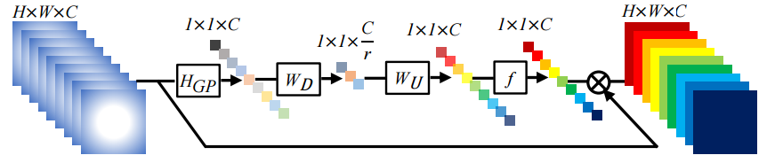
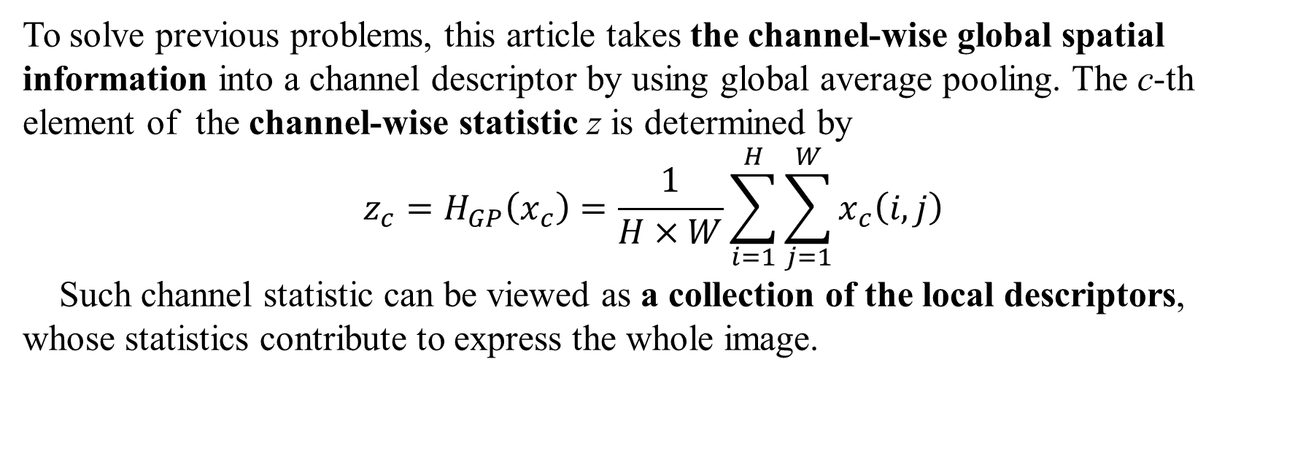
Channel Attention (CA)
Figure 2: Channel Attention.
To solve previous problems, this article takes the channel-wise global spatial
information into a channel descriptor by using global average pooling. The c-th element of the channel-wise statistic z is determined by
$$z_{c}=H_{GP}\left(x_{c}\right)=\frac{1}{H×W}\sum_{i=1}^{H}{\sum_{j=1}^{W}{x_{c}\left(i,j\right)}}$$
Such channel statistic can be viewed as a collection of the local descriptors, whose statistics contribute to express the whole image.

Slide 8
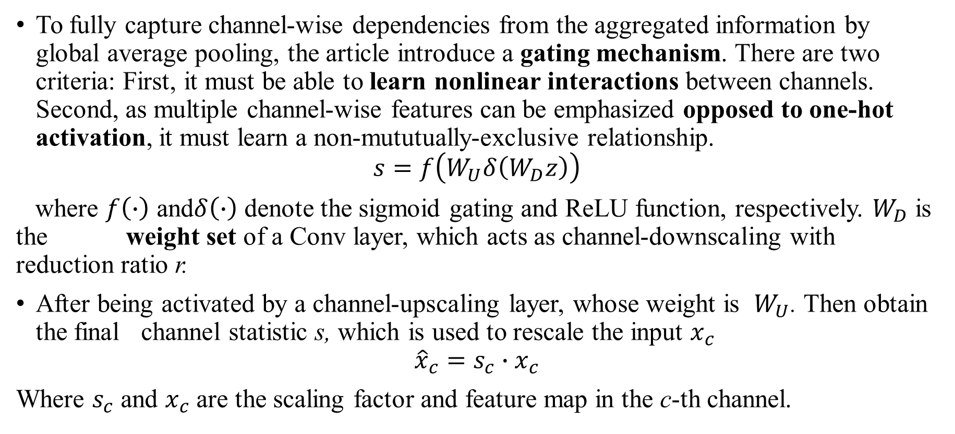
Channel Attention (CA)
To fully capture channel-wise dependencies from the aggregated information by global average pooling, the article introduce a gating mechanism. There are two criteria: First, it must be able to learn nonlinear interactions between channels. Second, as multiple channel-wise features can be emphasized opposed to one-hot activation, it must learn a non-mututually-exclusive relationship.
$$s=f\left(W_{U}δ\left(W_{D}z\right)\right)$$
where $f\left(∙\right)$ and$δ\left(∙\right)$ denote the sigmoid gating and ReLU function, respectively. $W_{D}$ is the weight set of a Conv layer, which acts as channel-downscaling with reduction ratio r.
After being activated by a channel-upscaling layer, whose weight is $W_{U}$. Then obtain the final channel statistic s, which is used to rescale the input $x_{c}$
$${\hat{x}}_{c}=s_{c}∙x_{c}$$
Where $s_{c}$ and $x_{c}$ are the scaling factor and feature map in the c-th channel.

Slide 9
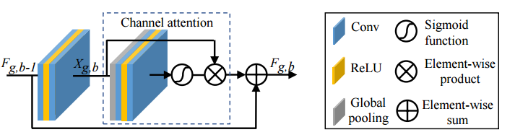
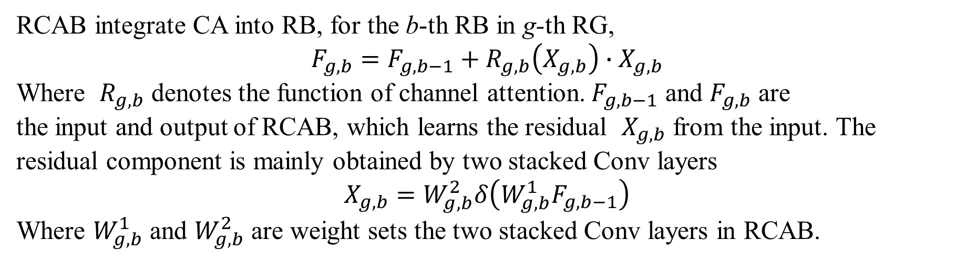
Residual channel attention block (RCAB)
RCAB integrate CA into RB, for the b-th RB in g-th RG,
$$F_{g,b}=F_{g,b−1}+R_{g,b}\left(X_{g,b}\right)∙X_{g,b}$$
Where $R_{g,b}$ denotes the function of channel attention. $F_{g,b−1}$ and $F_{g,b}$ are
the input and output of RCAB, which learns the residual $X_{g,b}$ from the input. The residual component is mainly obtained by two stacked Conv layers
$$X_{g,b}=W_{g,b}^{2}δ\left(W_{g,b}^{1}F_{g,b−1}\right)$$
Where $W_{g,b}^{1}$ and $W_{g,b}^{2}$ are weight sets the two stacked Conv layers in RCAB.

Slide 10
Conclusion
The residual in residual (RIR) structure allows RCAN to reach very large depth with LSC and SSC.
RIR allows abundant low-frequency information to be bypassed through multiple skip connections, making the main network focus on learning high-frequency information.
We propose channel attention (CA) mechanism to adaptively rescale channel-wise features by considering interdependencies among channels.

